Slide 1
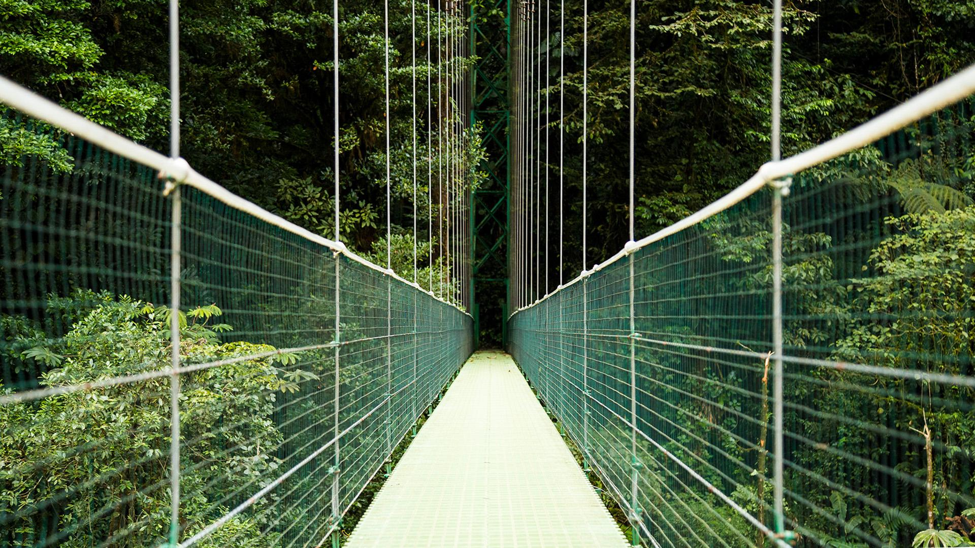
Makeup
of the
Cascades
Gabby John
10-26-2023

Slide 2
TABLE OF CONTENTS
01
02
03
04
GEOLOGY
VEGETATION
Geologic history of the Cascades ecoregion
Common plants, focusing on the Western Cascades
DISTURBANCES
FUTURE
Fire, slope-related disturbances, etc.
Research!

Slide 3
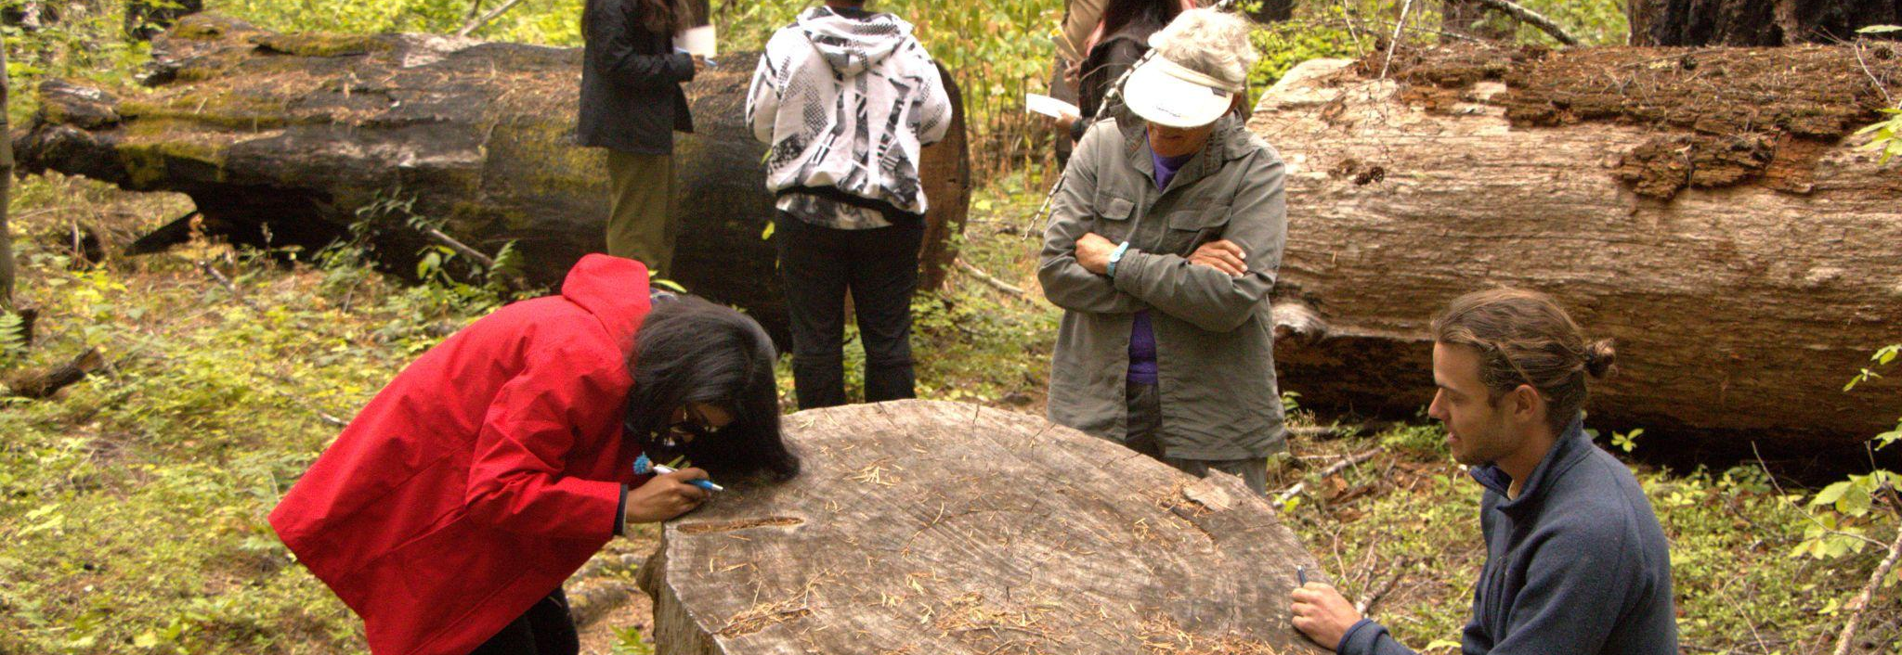
Field Research in Geomorphology: GEOG 596
Pre-term field trips over 4 days
H.J. Andrews LTER…not
Any photos/information not sourced comes from here!

Slide 4
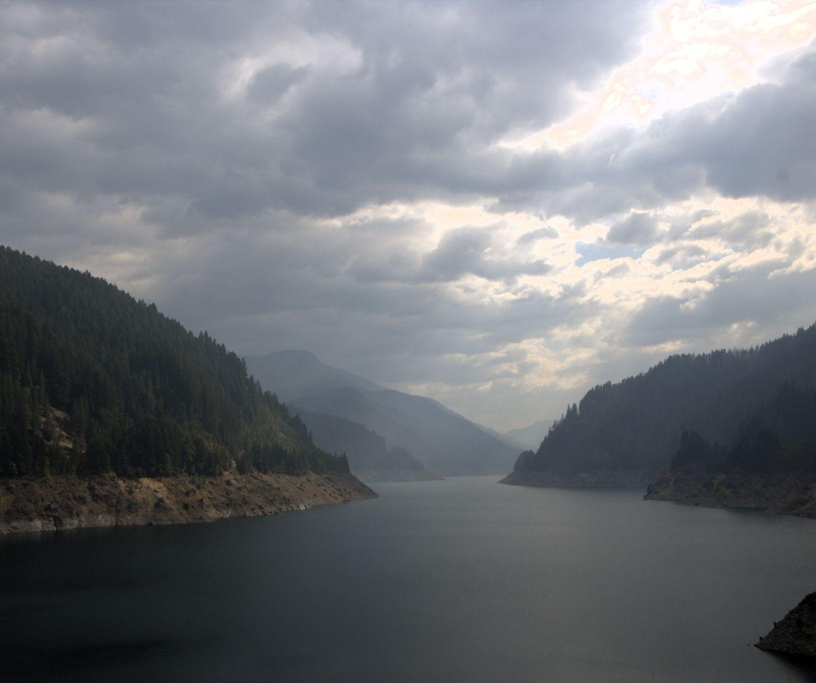
01
GEOLOGIC SETTING
of the Cascades region

Slide 5
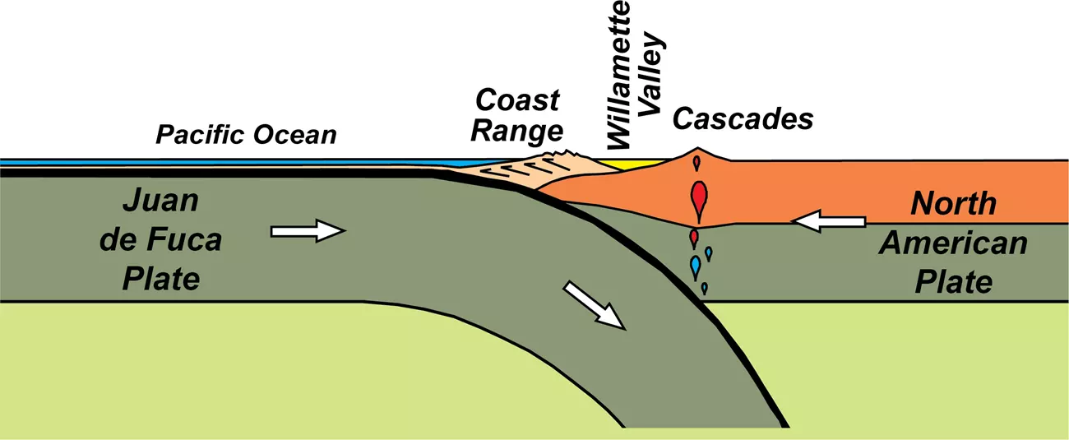
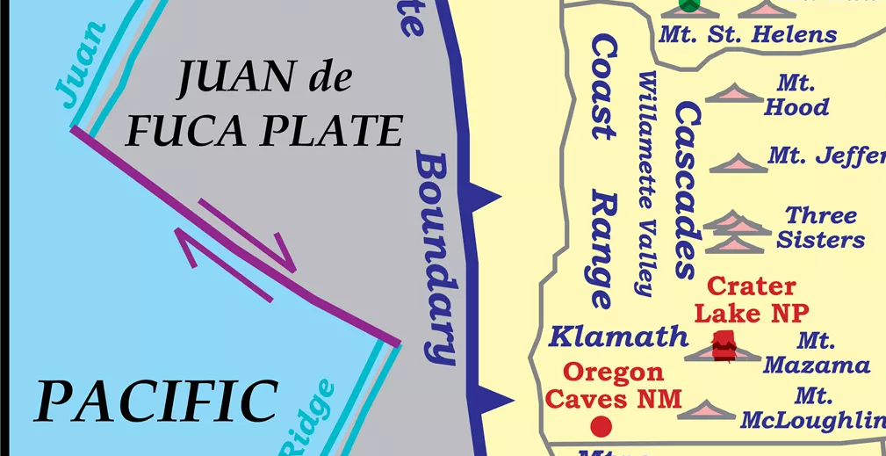
Plate Tectonics
The Cascades are one of two parallel mountain ranges that form the Cascadia Subduction Zone in the Pacific Northwest.
Occurs because of three tectonic plate interactions (third is the Pacific Plate
Cascades formed due to volcanic activity resulting from deep subduction generating hot magma that rose to the surface.
RING OF FIRE!
Source: https://www.nps.gov/subjects/geology/p late-tectonics-subduction-zones.htm

Slide 6
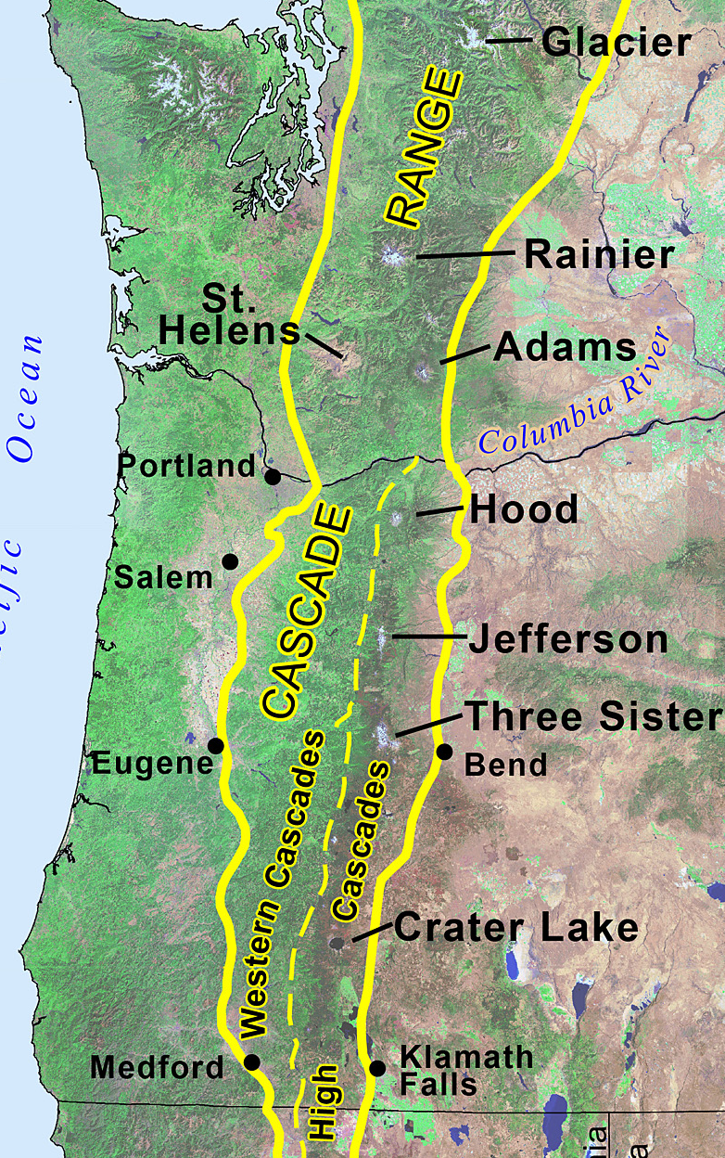
No two cascades are the same!
Western (old) Cascades
High Cascades
Western (old) Cascades
• ~30-40 MYA and therefore highly eroded • 1.7-5.8k feet in elevation • long, steep ridges • wide, glaciated valleys. • Basalt, andesite, tuff
• ~3-7 MYA, less eroded • More sparse yet active volcanic sites • Up to 14.4k feet • Similar geologic composition
Sources: oregonencyclopedia.org/articles/cascade_mountain_range/ oregonconservationstrategy.org/ecoregion/west-cascades/

Slide 7
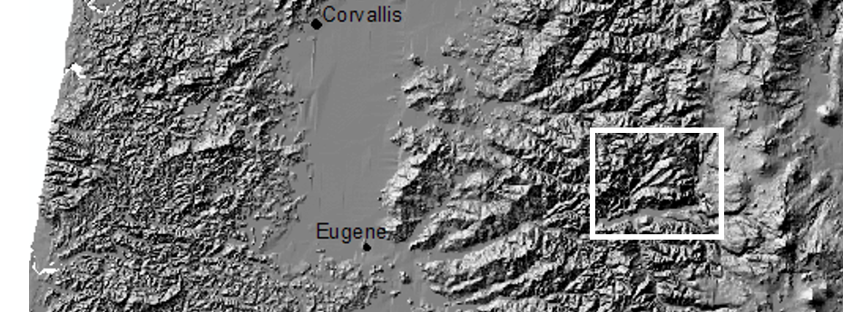
Relevance for our research
H.J. Andrews LTER is on the eastern side of the Western Cascades
Elevation ranges from 400m-1600m (1.3k-5.2k feet)
Geologic characteristics shape the landforms and life suitable in the area

Slide 8
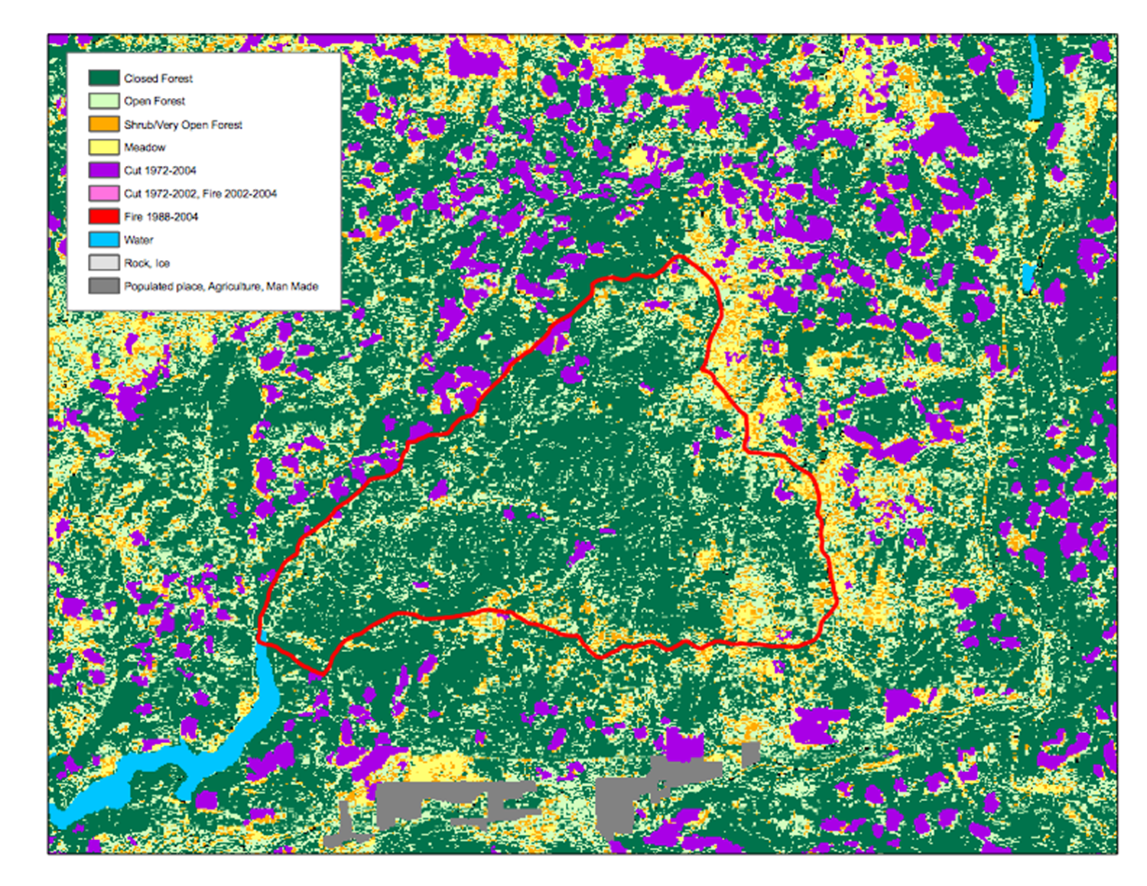

THIS IS A MAP
Mercury is the closest planet to the Sun and the smallest one in the Solar System

Slide 9
02
VEGETATION
of the Western Cascades

Slide 10
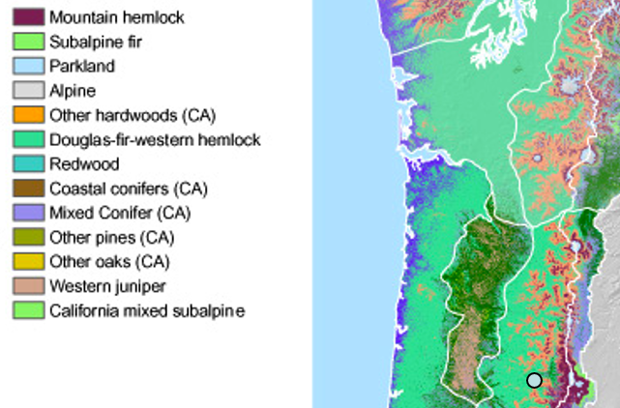
Western Cascade makeup
Douglas-fir - western hemlock natural vegetation zone.
Other common trees include western redcedar, grand fir, ponderosa pine, sugar pine, incense cedar, and noble fir.
Lots of conifers due to cool, dry summers and mild, wet winters
Pre-colonial vegetation included oak woodland and grassland
Invasive plants!!!
Source: oregonconservationstrategy.org/ecoregion/west-cascades/

Slide 11
03
DISTURBANCES
of the Western Cascades

Slide 12
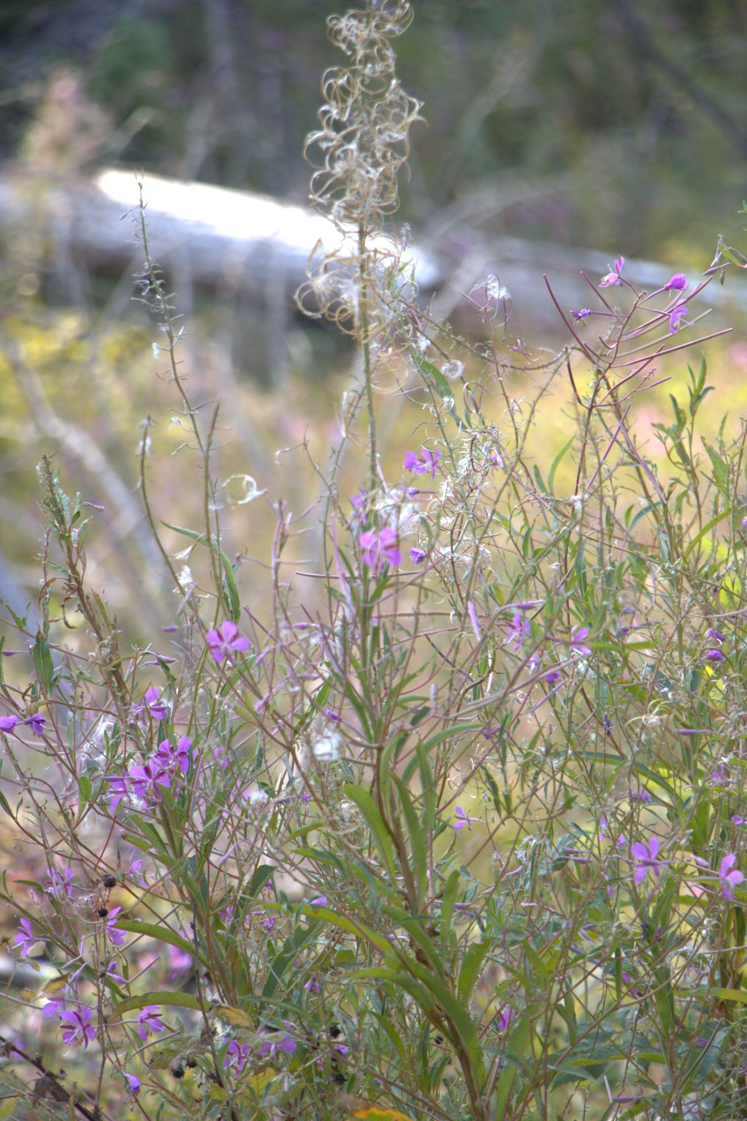
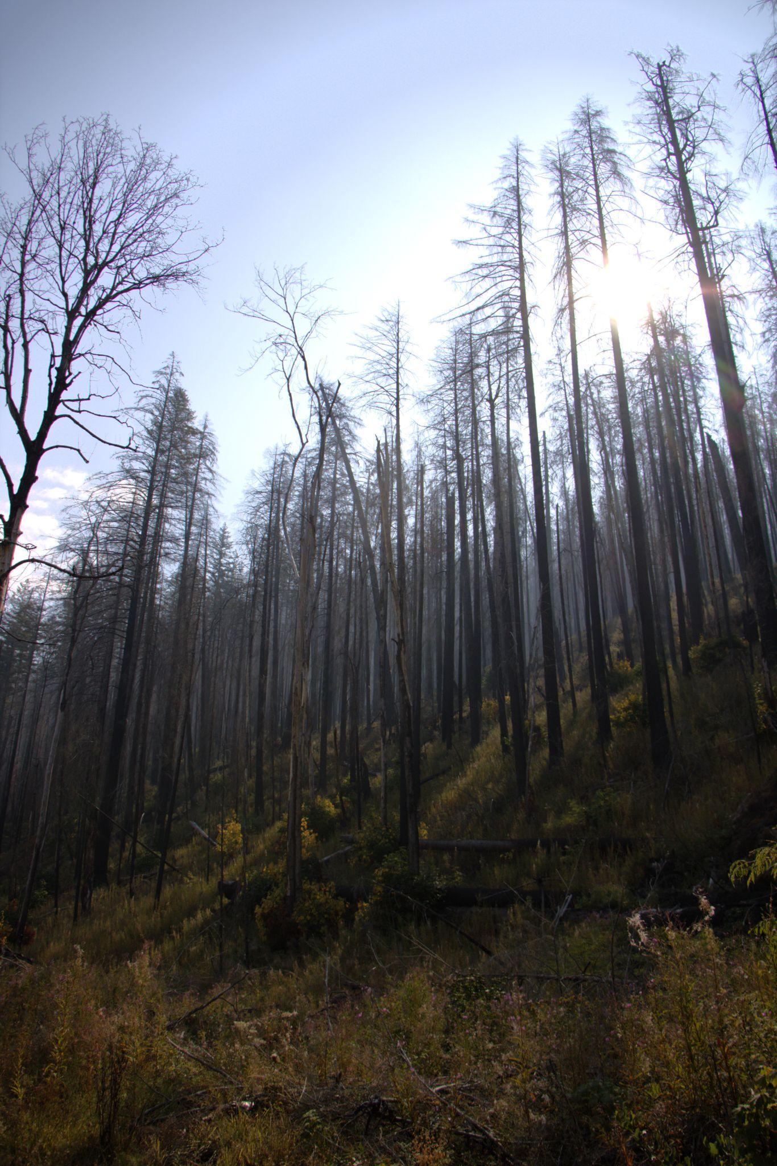
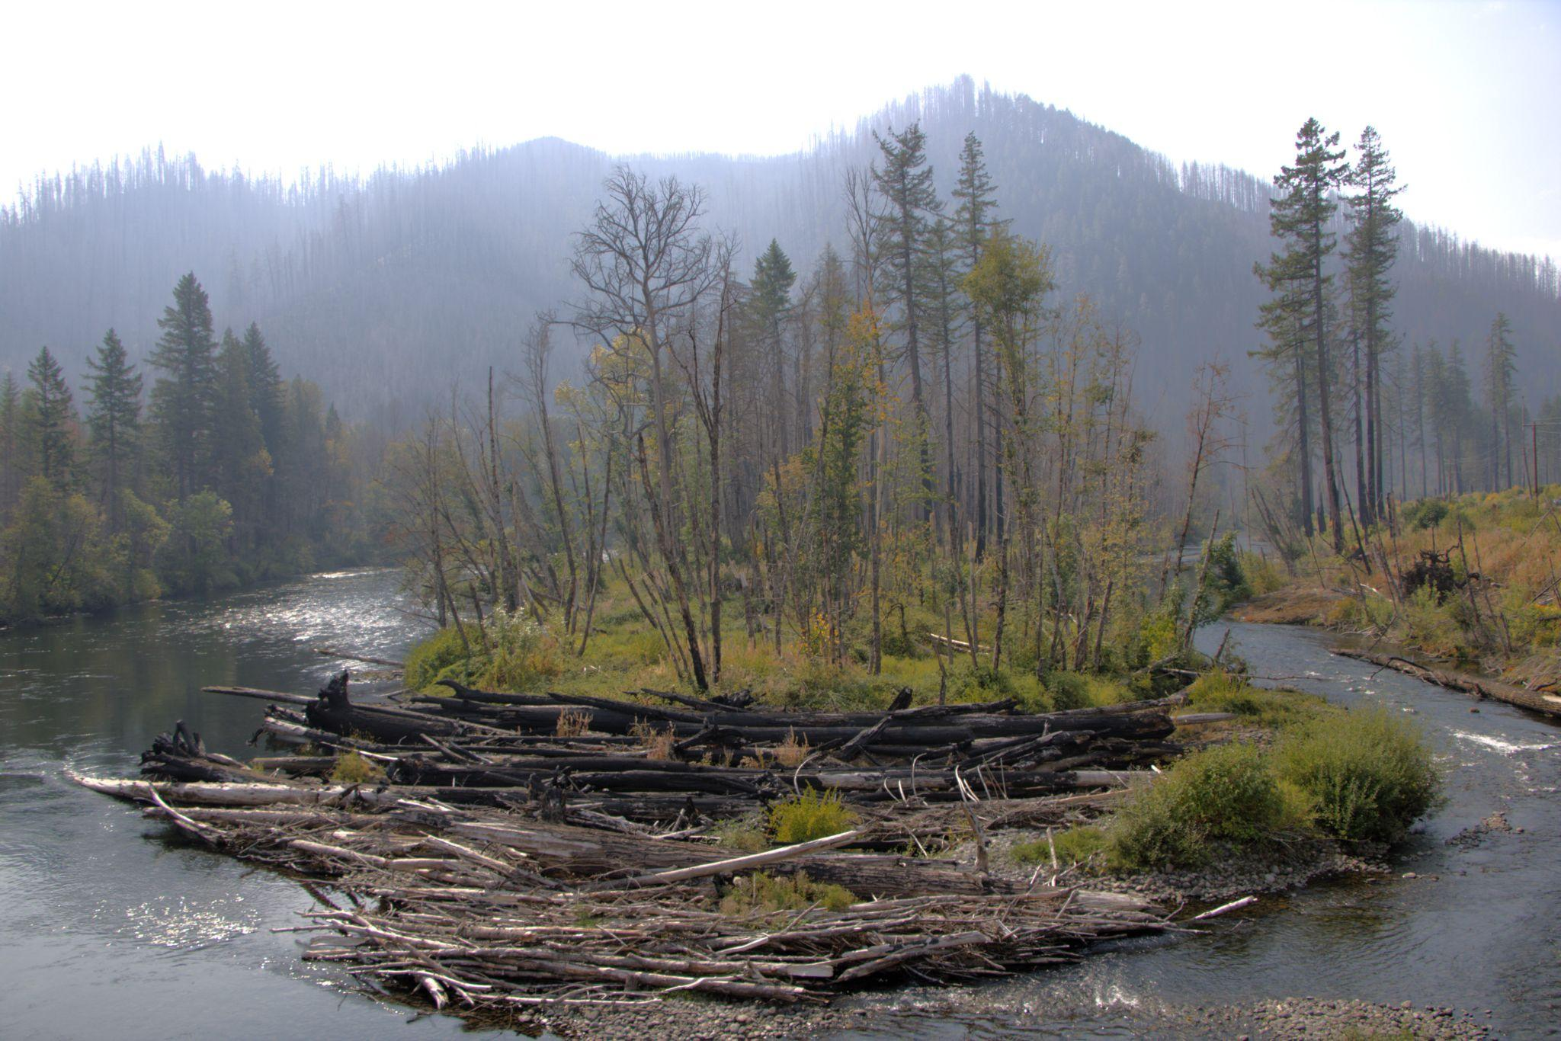
FIRE!!!!!!!!!!!!!!!!!!

Slide 13
Fire and human use plays an increasingly important role in the landscape
Some forests here have some of the highest per-acre biomass in the world!
Northern portion of the WC (usually) experiences a fire regime with less frequent but more severe fires
Southern portion is typically drier with more frequent fires caused by lightning
Many forests here are labeled Fire Regime Condition Class II, meaning fires occur every 0-35 years and are often stand-replacing.
Disrupted disturbance regimes have led to more severe wildfires and unnecessary destruction

Slide 14
Human use as a disturbance
As urbanization increases, so too does fire suppression into the early 2000s
Commercial west coast logging comes with industry and war
Post-WW2 logging and clearcutting facilitated post-war housing and was therefore deemed as positive
Leads to scarcity of old-growth and pervasive fire suppression
Cascades now protected under the Northwest Forest Plan
Pictured: Finn Rock within the McKenzie River

Slide 15
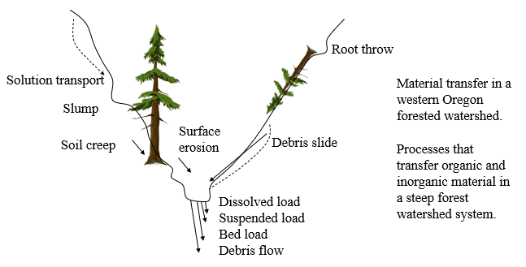
Other disturbances
One
Existing terrain challenges can have cascading (!) effects, especially when water is involved
Root-throw events and water process alterations e.g. Finn Rock Landing within the McKenzie River
Ultimately, everything is connected via a geo-eco-social system.
Dead =/= bad
Describe here the topic of the section and decide your next destination

Slide 16
04
RESEARCHING
the Western Cascades

Slide 17
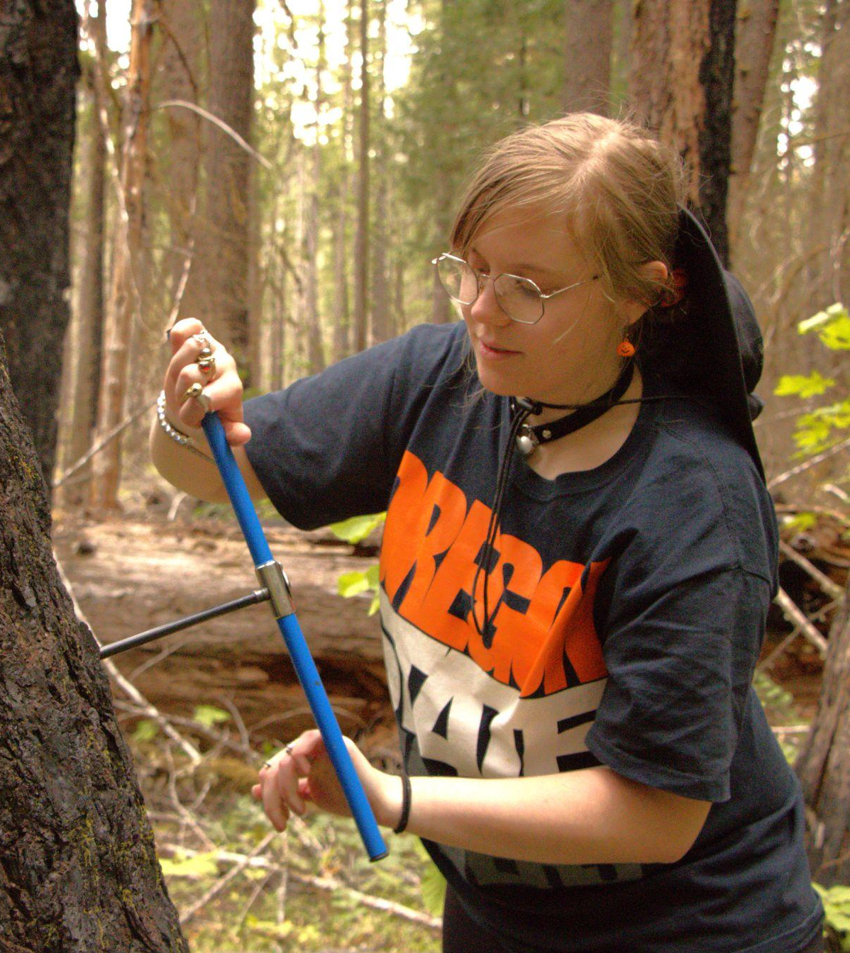
Talk about opportunity!
Shout out to Chris
Tree coring
Forensic ecology
Landscape history and common management practices/issues
First-hand interactions in undisturbed old-growth pieces of history (e.g. Echo Basin Trail)
Affirming interests
Management/conservation ideas

Slide 18
—Robin Wall Kimmerer, “Interview with a Watershed”
x
“...I like to think of scientific research as a conversation, an interview of sorts between two parties that don’t speak the same language.”

Slide 19
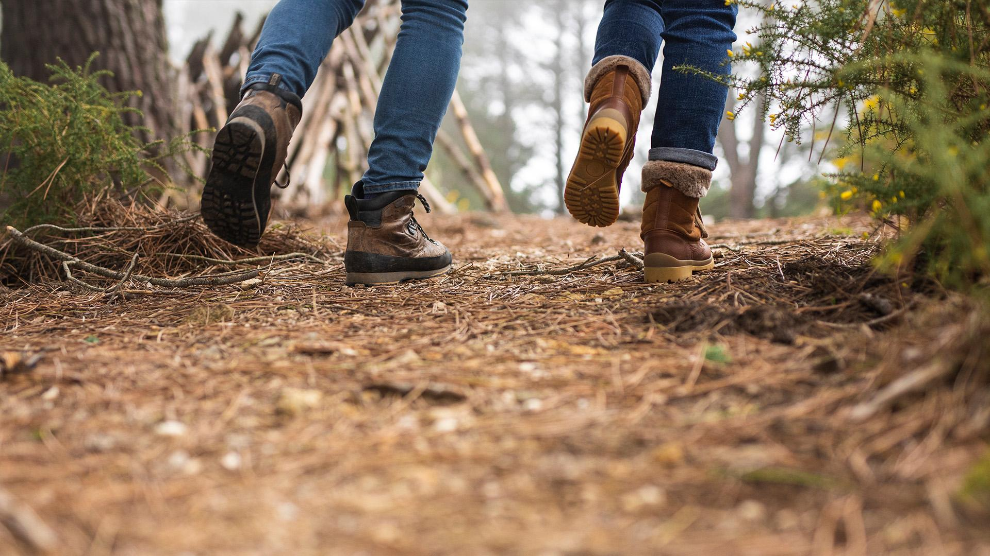
THANK YOU! :)
I’m honored to be here!

